Slide 1
PARLER LENTEMENT
(A mettre aussi sur une feuille)

Slide 2
University Physics – Mechanics: Lecture 3
Teacher: Dr. Paul Briard
Email: paulbriard@outlook.com
Wechat: Paulbg123
Notes:
PARLER LENTEMENT: Hello everybody ! It is a pleasure to teach you the third lesson about University Physics.

Slide 3
1.3. Acceleration in intrinsic coordinates
Notes:
PARLER LENTEMENT: Last time, I have described to you Cartesian coordinates systems x,y,z. In this coordinate system, we have seen together different kinds of vectors such as, the position vector, the velocity vector and the acceleration vector. These three kinds of vectors are used to describe the motion of a particle. Today, we will see another kind of coordinate which are the intrinsic coordinates and which are also you to describe the motion.

Slide 4




Intrinsic coordinates: Normal and tangent components of the acceleration vector
trajectory
$${\vec{a}}_{t}$$
$$P$$
$$\vec{a}$$
$${\vec{a}}_{n}$$
The acceleration vector can be described as the sum of two vectors:
Notes:
PARLER LENTEMENT: Here is a figure which describe the trajectory of the particle P. This particle has a certain acceleration vector, which describe how change its velocity. To describe the acceleration, instead of to use the Cartesian components of the acceleration vector: x, y, z, we describe now its intrinsic components On the figure, you can see the acceleration vector is the sum of two vectors, which describe its components.

Slide 5
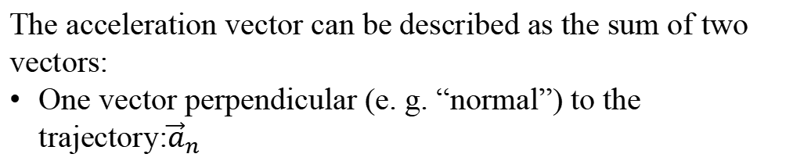
Intrinsic coordinates: Normal and tangent components of the acceleration vector
trajectory
$${\vec{a}}_{t}$$
$$P$$
$$\vec{a}$$
$${\vec{a}}_{n}$$
The acceleration vector can be described as the sum of two vectors:
One vector perpendicular (e. g. “normal”) to the trajectory:${\vec{a}}_{n}$
Notes:
PARLER LENTEMENT: You can see that at the point P, one vector is perpendicular to the trajectory. This vector is named a_n . It describe the normal components of the acceleration. In Physics, the word “normal” means “perpendicular”, here it is perpendicular to the trajectory. About this vector a_n, we speak about the normal acceleration.

Slide 6
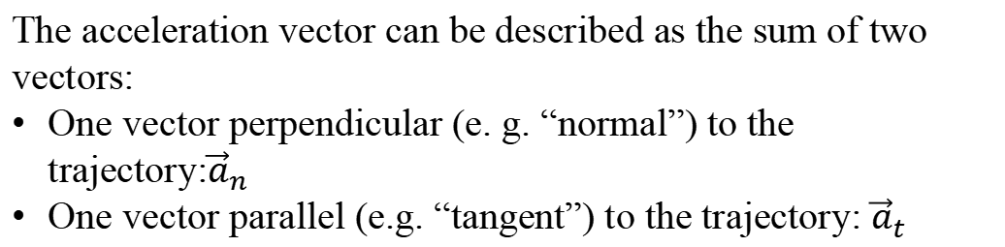
Intrinsic coordinates: Normal and tangent components of the acceleration vector
trajectory
$${\vec{a}}_{t}$$
$$P$$
$$\vec{a}$$
$${\vec{a}}_{n}$$
The acceleration vector can be described as the sum of two vectors:
One vector perpendicular (e. g. “normal”) to the trajectory:${\vec{a}}_{n}$
One vector parallel (e.g. “tangent”) to the trajectory: ${\vec{a}}_{t}$
Notes:
PARLER LENTEMENT: The second vector is parallel to the trajectory, which means it has the same direction. This vector is named a_t and describe the tangential component of the acceleration. About it, we speak about “tangential acceleration”. As you know, the velocity vector is also tangent to the trajectory. So, the velocity vector and the tangential acceleration have the same direction.

Slide 7


Normal and tangent components of the acceleration vector
$$\vec{a}={\vec{a}}_{t}+{\vec{a}}_{n}$$
$${\vec{a}}_{t}$$
$$\vec{a}=a_{t}\hat{t}+a_{n}\hat{n}$$
$$P$$
$$\vec{a}$$
where:
$${\vec{a}}_{n}$$
Notes:
PARLER LENTEMENT. As for Cartesian coordinates, we can describe the acceleration using its components and unit vectors. The first equation describe simply the acceleration has the sum of the normal acceleration and the tangential acceleration. The second equation describe the acceleration with its components and unit vectors.

Slide 8
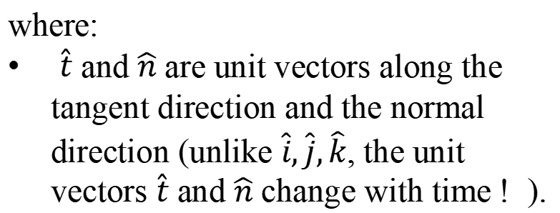
Normal and tangent components of the acceleration vector
$$\vec{a}={\vec{a}}_{t}+{\vec{a}}_{n}$$
$${\vec{a}}_{t}$$
$$\vec{a}=a_{t}\hat{t}+a_{n}\hat{n}$$
$$P$$
$$\vec{a}$$
where:
$\hat{t}$ and $\hat{n}$ are unit vectors along the tangent direction and the normal direction (unlike $\hat{i},\hat{j},\hat{k}$, the unit vectors $\hat{t}$ and $\hat{n}$ change with time ! ).
$${\vec{a}}_{n}$$
Notes:
PARLER LENTEMENT: This unit vectors are the vectors t and n. As for Cartesian units vectors, I use a hat on them to say “these are unit vectors”. These unit vectors are tangent and normal to the trajectory. Take care because unlike the Cartesian unit vectors we have seen last time, the unit vectors change when the particle is in motion. This is because the direction of motion change when the particle is moving.

Slide 9
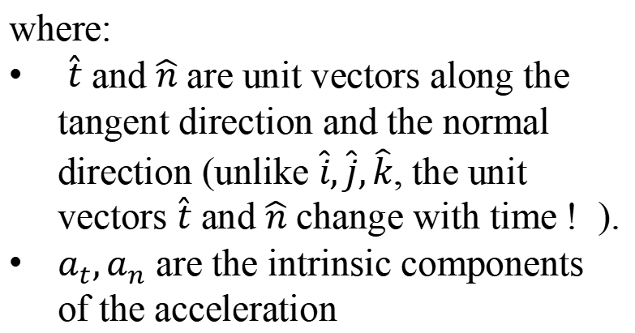
Normal and tangent components of the acceleration vector
$$\vec{a}={\vec{a}}_{t}+{\vec{a}}_{n}$$
$${\vec{a}}_{t}$$
$$\vec{a}=a_{t}\hat{t}+a_{n}\hat{n}$$
$$P$$
$$\vec{a}$$
where:
$\hat{t}$ and $\hat{n}$ are unit vectors along the tangent direction and the normal direction (unlike $\hat{i},\hat{j},\hat{k}$, the unit vectors $\hat{t}$ and $\hat{n}$ change with time ! ).
$a_{t},a_{n}$ are the intrinsic components of the acceleration
$${\vec{a}}_{n}$$
Notes:
PARLER LENTEMENT: And a_t and a_n are the magnitudes of the tangential acceleration and the normal acceleration. So they are the intrinsic components of the acceleration vectors.

Slide 10
Normal and tangent components of the acceleration vector
$$\vec{a}={\vec{a}}_{t}+{\vec{a}}_{n}$$
$$\vec{v}$$
$${\vec{a}}_{t}$$
$$\vec{a}=a_{t}\hat{t}+a_{n}\hat{n}$$
$$P$$
$$\vec{a}$$
$${\vec{a}}_{n}$$
$$ρ$$
Notes:
PARLER LENTEMENT: Now let see few more details about the trajectory. As we have seen together last time, The particle P has a certain velocity vector, which is named v in the figure. This velocity vector is tangent to the trajectory and has the same direction than the tangential acceleration vector. On the figure, from P you can see a dashed line with the greeck letter rho.

Slide 11
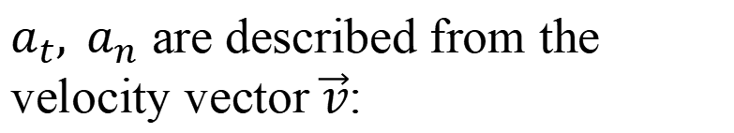
Normal and tangent components of the acceleration vector
$$\vec{a}={\vec{a}}_{t}+{\vec{a}}_{n}$$
$$\vec{v}$$
$${\vec{a}}_{t}$$
$$\vec{a}=a_{t}\hat{t}+a_{n}\hat{n}$$
$$P$$
$$\vec{a}$$
$${\vec{a}}_{n}$$
$a_{t}, a_{n}$ are described from the velocity vector $\vec{v}$:
$$ρ$$
Notes:
PARLER LENTEMENT: The tangential and normal components of the acceleration can be described from the velocity vectors of the particle. This is not a big surprise since we know how the velocity and the acceleration are related together.

Slide 12
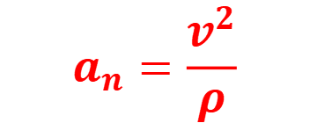
Normal and tangent components of the acceleration vector
$$\vec{a}={\vec{a}}_{t}+{\vec{a}}_{n}$$
$$\vec{v}$$
$${\vec{a}}_{t}$$
$$\vec{a}=a_{t}\hat{t}+a_{n}\hat{n}$$
$$P$$
$$\vec{a}$$
$${\vec{a}}_{n}$$
$a_{t}, a_{n}$ are described from the velocity vector $\vec{v}$:
$$ρ$$
$$a_{n}=\frac{v^{2}}{ρ}$$
$ρ$: radius of curvature of the trajectory, which depends on the position of the particle P along its trajectory.
Notes:
PARLER LENTEMENT: First, lets describe the normal component acceleration. You can see that the square of the velocity of the particle divided by this distance rho. Rho is the radius of curvature of the trajectory, which depends on the position of the particle P along its trajectory. Of course, it depends also to the trajectory.

Slide 13
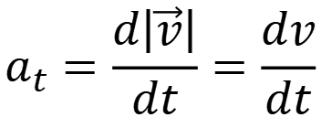
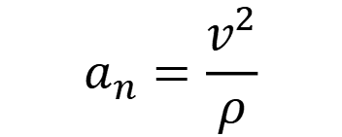
Normal and tangent components of the acceleration vector
$$\vec{a}={\vec{a}}_{t}+{\vec{a}}_{n}$$
$$\vec{v}$$
$${\vec{a}}_{t}$$
$$\vec{a}=a_{t}\hat{t}+a_{n}\hat{n}$$
$$P$$
$$\vec{a}$$
$${\vec{a}}_{n}$$
$a_{t}, a_{n}$ are described from the velocity vector $\vec{v}$:
$$ρ$$
$$a_{n}=\frac{v^{2}}{ρ}$$
$$a_{t}=\frac{d\left|\vec{v}\right|}{dt}=\frac{dv}{dt}$$
$ρ$: radius of curvature of the trajectory, which depends on the position of the particle P along its trajectory.
Notes:
PARLER LENTEMENT: Now lets describe the tangential component of the acceleration. It is simply the time derivative of the magnitude of the velocity vector, which is what we name “the instantaneous velocity ” I have described you last time.

Slide 14
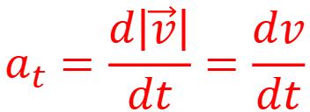
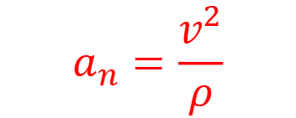
Normal and tangent components of the acceleration vector
$$\vec{a}={\vec{a}}_{t}+{\vec{a}}_{n}$$
$$\vec{v}$$
$${\vec{a}}_{t}$$
$$\vec{a}=a_{t}\hat{t}+a_{n}\hat{n}$$
$$P$$
$$\vec{a}$$
$${\vec{a}}_{n}$$
$a_{t}, a_{n}$ are described from the velocity vector $\vec{v}$:
$$ρ$$
$$a_{n}=\frac{v^{2}}{ρ}$$
$$a_{t}=\frac{d\left|\vec{v}\right|}{dt}=\frac{dv}{dt}$$
Important to remember
Notes:
PARLER LENTEMENT: Here I say you that these two expressions are important to remember. Because they permit to describe the acceleration. They can also be used to describe what is the radius of curvature of a trajectory.

Slide 15


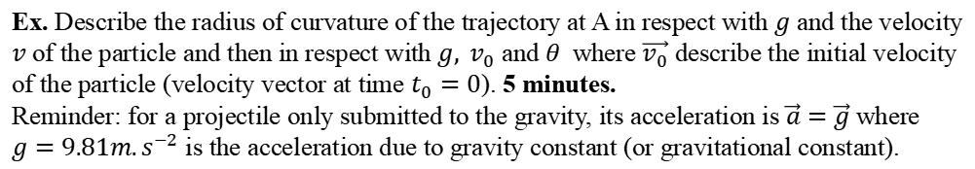


About the radius of curvature of the trajectory
The radius of curvature $ρ$ of the trajectory at depends on the motion studied.
For instance, here is a motion of a projectile only submitted to the gravity. The radius of curvature at A and B are different.
$$y$$
$$A$$
$$\vec{g}$$
•
$$θ$$
$$B$$
$$x$$
$$O$$
Ex. Describe the radius of curvature of the trajectory at A in respect with $g$ and the velocity $v$ of the particle and then in respect with $g, v_{0}$ and $θ$ where $\vec{v_{0}}$ describe the initial velocity of the particle (velocity vector at time $t_{0}=0$). 5 minutes.
Reminder: for a projectile only submitted to the gravity, its acceleration is $\vec{a}=\vec{g}$ where $g=9.81{m.s}^{−2}$ is the acceleration due to gravity constant (or gravitational constant).
Notes:
PARLER LENTEMENT: To show how it is possible to describe the radius of curvature of a trajectory. Here is a little exercise to try to do in 5 minutes. In the figure, you can see that we consider a parabolic motion of a particle, for instance it is the motion of a projectile only submitted to the gravity. The vector g describe the gravitational acceleration of the acceleration. You can see two points A and B. The radius of curvature of the trajectory is not the same at A and B. At the origin of this Cartesian system, a person throw the projectile with a certain initial velocity, described by the vector v0. Please to try to describe from what we have seen the radius of curvature at the point A. I give you the solution in 5 minutes.

Slide 16




Solution
$$y$$
$$A$$
$$\vec{v}$$
$$\vec{a}=\vec{g}$$
•
$$θ$$
$$x$$
$$O$$
At point A:
$$a_{t}=0$$
$$a_{n}=a$$
(no tangential acceleration at A, $\vec{a}$ is directed downward)
Notes:
PARLER LENTEMENT: So, first we have to describe what is the acceleration at the point A. The projectile is only submitted to the gravity, which means its acceleration vector is also the gravitational acceleration g. As you can see on the figure, the gravitational acceleration is directed downward. So, the acceleration vector is also directed downward. This means that at the point A, the projectile have no tangential acceleration. And then the direction of the acceleration vector is normal to the trajectory.

Slide 17
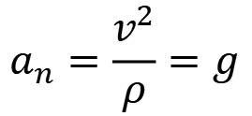
Solution
$$y$$
$$A$$
$$\vec{v}$$
$$\vec{a}=\vec{g}$$
•
$$θ$$
$$x$$
$$O$$
At point A:
$$a_{t}=0$$
$$a_{n}=a$$
(no tangential acceleration at A, $\vec{a}$ is directed downward)
$$a_{n}=\frac{v^{2}}{ρ}=g$$
Notes:
PARLER LENTEMENT: Then we just have to apply the equation which describe the normal acceleration. You can see a relationship between the radius of curvature of the trajectory and the gravitational acceleration.

Slide 18

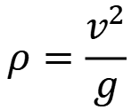
Solution
$$y$$
$$A$$
$$\vec{v}$$
$$\vec{a}=\vec{g}$$
•
$$θ$$
$$x$$
$$O$$
At point A:
$$a_{t}=0$$
$$a_{n}=a$$
(no tangential acceleration at A, $\vec{a}$ is directed downward)
$$a_{n}=\frac{v^{2}}{ρ}=g$$
$$ρ=\frac{v^{2}}{g}$$
where
$v$ is the velocity at A
Notes:
PARLER LENTEMENT: Finally, we succeed to describe the radius of curvature of the trajectory. However, this equation is not what is asked by the exercise. We have to describe it in terms of the initial velocity v0 of the projectile.

Slide 19


Solution
$$y$$
$$A$$
$$\vec{v}$$
$$\vec{a}=\vec{g}$$
•
$$θ$$
$$x$$
$$O$$
At point A:
$$a_{t}=0$$
$$a_{n}=a$$
(no tangential acceleration at A, $\vec{a}$ is directed downward)
$$a_{n}=\frac{v^{2}}{ρ}=g$$
$$ρ=\frac{v^{2}}{g}$$
where
$v$ is the velocity at A
Initial velocity components:
$$v_{0x}=v_{0}\cos{θ}$$
$$v_{0y}=v_{0}\sin{θ}$$
Velocity components:
Notes:
PARLER LENTEMENT: Let’s see the initial velocity components. As you can see and the figure, they depend to the angle theta, the angle between the initial velocity vector and the x-axis.

Slide 20



Solution
$$y$$
$$A$$
$$\vec{v}$$
$$\vec{a}=\vec{g}$$
•
$$θ$$
$$x$$
$$O$$
At point A:
$$a_{t}=0$$
$$a_{n}=a$$
(no tangential acceleration at A, $\vec{a}$ is directed downward)
$$a_{n}=\frac{v^{2}}{ρ}=g$$
$$ρ=\frac{v^{2}}{g}$$
where
$v$ is the velocity at A
Initial velocity components:
$$v_{0x}=v_{0}\cos{θ}$$
$$v_{0y}=v_{0}\sin{θ}$$
Velocity components:
$$v_{x}=v_{0x}=v_{0}\cos{θ}$$
( because $\vec{a}$ is directed downward)
$$v_{y}=v_{0y}+a_{y}t=v_{0y}−gt$$
Notes:
PARLER LENTEMENT: Now lets describe the components of the velocity vectors. We know the accerlation vectors is downward. This means there is no change about the x-component of the velocity. The x-component of the velocity is then the x-component of the initial velocity v0. But there is a change of the y-component of the velocity, described by the following equation. a_y is simply the y-component of the acceleration vector.

Slide 21
Solution
$$y$$
$$A$$
$$\vec{v}$$
$$\vec{a}=\vec{g}$$
•
$$θ$$
$$x$$
$$O$$
At point A:
$$a_{t}=0$$
$$a_{n}=a$$
(no tangential acceleration at A, $\vec{a}$ is directed downward)
$$a_{n}=\frac{v^{2}}{ρ}=g$$
$$ρ=\frac{v^{2}}{g}$$
where
$v$ is the velocity at A
Initial velocity components:
$$v_{0x}=v_{0}\cos{θ}$$
$$v_{0y}=v_{0}\sin{θ}$$
Velocity components:
$$v_{x}=v_{0x}=v_{0}\cos{θ}$$
( because $\vec{a}$ is directed downward)
$$v_{y}=v_{0y}+a_{y}t=v_{0y}−gt$$
And at point A, $v_{y}=0 ,$ $v=v_{x}=v_{0}\cos{θ}$
Notes:
PARLER LENTEMENT: The point A is a particular point of the trajectory. It is the top of the trajectory, at which the velocity vector has same direction than the x-axis.

Slide 22
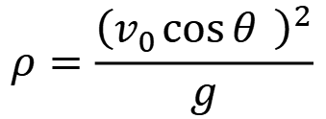
Solution
$$y$$
$$A$$
$$\vec{v}$$
$$\vec{a}=\vec{g}$$
•
$$θ$$
$$x$$
$$O$$
At point A:
$$a_{t}=0$$
$$a_{n}=a$$
(no tangential acceleration at A, $\vec{a}$ is directed downward)
$$a_{n}=\frac{v^{2}}{ρ}=g$$
$$ρ=\frac{v^{2}}{g}$$
where
$v$ is the velocity at A
Initial velocity components:
$$v_{0x}=v_{0}\cos{θ}$$
$$v_{0y}=v_{0}\sin{θ}$$
Velocity components:
$$v_{x}=v_{0x}=v_{0}\cos{θ}$$
( because $\vec{a}$ is directed downward)
$$v_{y}=v_{0y}+a_{y}t=v_{0y}−gt$$
$$ρ=\frac{{\left(v_{0}\cos{θ} \right)}^{2}}{g}$$
And at point A, $v_{y}=0 ,$ $v=v_{x}=v_{0}\cos{θ}$
Notes:
PARLER LENTEMENT. This permits to obtain finally the radius of curvature of the trajectory of A. If you are interested to describe the radius of curvature at B, you will certainly find another expression. Maybe, this exercise was a bit long to do it in 5 minutes, but you can try later to see if you obtain the same result than me.

Slide 23
1.4. Description of the circular motion

Slide 24





Case of the uniform circular motion
$$\vec{v}$$
The direction of $\vec{v}$ change with the time, but
$v=Cte$ (the magnitude of the velocity vector is constant)
$$\vec{v}$$
$$\vec{a}$$
$$\frac{dv}{dt}=0$$
$$\vec{a}$$
$$\vec{a}$$
$$r$$
$$\vec{v}$$
Notes:
PARLER LENTEMENT: Now, let’s see the particular case of the uniform circular motion. At the figure, you can see an example of uniform circular motion of radius r. As always, the velocity vector is perpendicular to the trajectory which describe here a circle. And the magnitude of this velocity vector stays constant, because the motion is uniform. Only its direction change with the time. So, what happens for the time derivative the velocity ? It is simply equals 0.

Slide 25
Case of the uniform circular motion
$$\vec{v}$$
The direction of $\vec{v}$ change with the time, but
$v=Cte$ (the magnitude of the velocity vector is constant)
$$\vec{v}$$
$$\vec{a}$$
$$\frac{dv}{dt}=0$$
$$\vec{a}$$
$$\vec{a}$$
$$r$$
The radius of curvature of the trajectory is constant: $ρ=r$
$$\vec{v}$$
Notes:
PARLER LENTEMENT: Also, in this particular case, the radius of curvature of the trajectory is constant and is the radius of the circle.

Slide 26
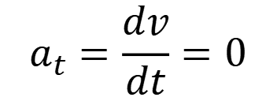
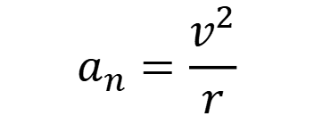
Case of the uniform circular motion
$$\vec{v}$$
The direction of $\vec{v}$ change with the time, but
$v=Cte$ (the magnitude of the velocity vector is constant)
$$\vec{v}$$
$$\vec{a}$$
$$\frac{dv}{dt}=0$$
$$\vec{a}$$
$$\vec{a}$$
$$r$$
The radius of curvature of the trajectory is constant: $ρ=r$
$$\vec{v}$$
$$a_{n}=\frac{v^{2}}{r}$$
$$a_{t}=\frac{dv}{dt}=0$$
Notes:
PARLER LENTEMENT: So, let’s describe the intrinsic components of the acceleration. You can see that the tangential acceleration is zero. The direction of the acceleration vector is then normal to the trajectory. This is what you can see on the figure. The acceleration vector is always directed toward the center of the circle. Also, its magnitude don’t change with the time, but its direction change with the motion, as for the velocity vector.

Slide 27
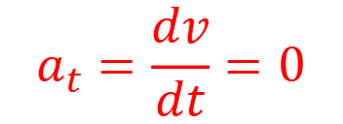
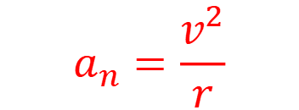
Case of the uniform circular motion
$$\vec{v}$$
The direction of $\vec{v}$ change with the time, but
$v=Cte$ (the magnitude of the velocity vector is constant)
$$\vec{v}$$
$$\vec{a}$$
$$\frac{dv}{dt}=0$$
$$\vec{a}$$
$$\vec{a}$$
$$r$$
The radius of curvature of the trajectory is constant: $ρ=r$
$$\vec{v}$$
$$a_{n}=\frac{v^{2}}{r}$$
$$a_{t}=\frac{dv}{dt}=0$$
Important to remember
Notes:
PARLER LENTEMENT: Please to remember the particular case of the uniform circular motion because it will be very useful later.

Slide 28
Case of the uniform circular motion
$$\vec{v}$$
The direction of $\vec{v}$ change with the time, but
$v=Cte$ (the magnitude of the velocity vector is constant)
$$\vec{v}$$
$$\vec{a}$$
$$\frac{dv}{dt}=0$$
$$\vec{a}$$
$$\vec{a}$$
$$r$$
The radius of curvature of the trajectory is constant: $ρ=r$
$$\vec{v}$$
$$a_{n}=\frac{v^{2}}{r}$$
$$a_{t}=\frac{dv}{dt}=0$$
Important to remember
$r$ is the radius of the circular motion
Notes:
PARLER LENTEMENT: The radius r which appears in the expression of the tangential acceleration is also the radius of the circular motion.

Slide 29

Case of the uniform circular motion
$$\vec{v}$$
The direction of $\vec{v}$ change with the time, but
$v=Cte$ (the magnitude of the velocity vector is constant)
$$\vec{v}$$
$$\vec{a}$$
$$\frac{dv}{dt}=0$$
$$\vec{a}$$
$$\vec{a}$$
$$r$$
The radius of curvature of the trajectory is constant: $ρ=r$
$$\vec{v}$$
$$a_{n}=\frac{v^{2}}{r}$$
$$a_{t}=\frac{dv}{dt}=0$$
Important to remember
$r$ is the radius of the circular motion
$$a=\frac{v^{2}}{r}$$
The magnitude of the acceleration vector is constant and equals:
Notes:
PARLER LENTEMENT: And the magnitude of the acceleration is simply the normal acceleration. You can see it is a motion which is not difficult to describe.

Slide 30
Case of the uniform circular motion
$$\vec{v}$$
The direction of $\vec{v}$ change with the time, but
$v=Cte$ (the magnitude of the velocity vector is constant)
$$\vec{v}$$
$$\vec{a}$$
$$\frac{dv}{dt}=0$$
$$\vec{a}$$
$$\vec{a}$$
$$r$$
The radius of curvature of the trajectory is constant: $ρ=r$
$$\vec{v}$$
$$a_{n}=\frac{v^{2}}{r}$$
$$a_{t}=\frac{dv}{dt}=0$$
Important to remember
$r$ is the radius of the circular motion
$$a=\frac{v^{2}}{r}$$
The magnitude of the acceleration vector is constant and equals:
The direction of the acceleration vector is always directed radially inward the circle.
Notes:
PARLER LENTEMENT: Finnaly, the direction of the acceleration vector is always perpendicular to the trajectory in this particular case, and then radially inward, which means directed toward the center of the circle,

Slide 31
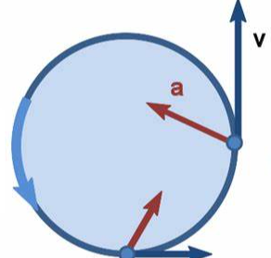
Case of the non-uniform circular motion
$$r$$
The radius of curvature of the trajectory is constant: $ρ=r$
Notes:
PARLER LENTEMENT: Here is a case of motion close to the previous one. The non-uniform circular motion. In this case also the radius of curvature of the trajectory is constant corresponding to the radius of the circle. But now, the acceleration vector is not always directed toward the center of the circle.

Slide 32
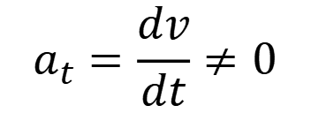
Case of the non-uniform circular motion
$$r$$
The radius of curvature of the trajectory is constant: $ρ=r$
$$a_{n}=\frac{v^{2}}{r}$$
$$a_{t}=\frac{dv}{dt}≠0$$
Notes:
PARLER LENTEMENT: The normal acceleration is the same than for the uniform circular motion. But now, the tangential acceleration is not zero. What is its value ? This depends to the motion.

Slide 33
Case of the non-uniform circular motion
$$r$$
The radius of curvature of the trajectory is constant: $ρ=r$
$$a_{n}=\frac{v^{2}}{r}$$
$$a_{t}=\frac{dv}{dt}≠0$$
Important to remember
Notes:
PARLER LENTEMENT: Please to remember also the case of the non-uniform circular motion/

Slide 34
Case of the non-uniform circular motion
$$r$$
The radius of curvature of the trajectory is constant: $ρ=r$
$$a_{n}=\frac{v^{2}}{r}$$
$$a_{t}=\frac{dv}{dt}≠0$$
Important to remember
$r$ is the radius of the circular motion
Notes:
PARLER LENTEMENT: where r is the radius of the circular motion.

Slide 35
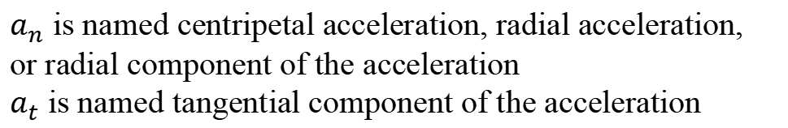
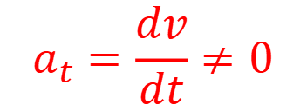
Case of the non-uniform circular motion
$$r$$
The radius of curvature of the trajectory is constant: $ρ=r$
$$a_{n}=\frac{v^{2}}{r}$$
$$a_{t}=\frac{dv}{dt}≠0$$
Important to remember
$r$ is the radius of the circular motion
$a_{n}$ is named centripetal acceleration, radial acceleration, or radial component of the acceleration
$a_{t}$ is named tangential component of the acceleration
Notes:
PARLER LENTEMENT: You can see here than the normal acceleration has different kinds of name: centripetal acceleration, radial acceleration or radial component of the acceleration.

Slide 36
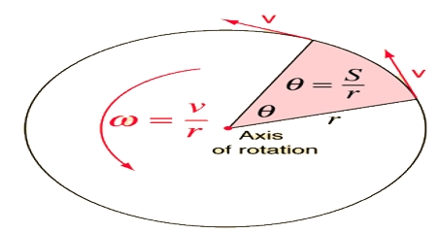

Angular velocity and angular acceleration
The length $S$ travelled along the circular path of radius $r$ corresponding to a angle $θ$ is:
p
Notes:
PARLER LENTEMENT: Now, let’s discuss about the path travelled by the particle during the circular motion, which could be uniform or non-uniform. As you can see it is related with the angle drawn during the motion of the particle. This angle theta is the ratio between the path travelled S and the radius r of the circle.

Slide 37

Angular velocity and angular acceleration
The length $S$ travelled along the circular path of radius $r$ corresponding to a angle $θ$ is:
$$S=rθ$$
p
Notes:
PARLER LENTEMENT: So we can describe this length S as the product between the radius of the circle and the angle theta. S is also the curvilinear coordinate I have decribed to you last week. You can see an example where it can be use to describe a motion.

Slide 38
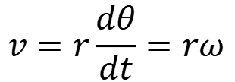

Angular velocity and angular acceleration
The length $S$ travelled along the circular path of radius $r$ corresponding to a angle $θ$ is:
$$S=rθ$$
The velocity $v={dS}/{dt}$ is then:
p
$$v=r\frac{dθ}{dt}=rω$$
Notes:
PARLER LENTEMENT. The velocity is the time derivative of the length L travelled along the path of the trajectory, so we can describe as the product between the radius of the circle and the time derivative of the angle theta, which named the angular velocity “omega”

Slide 39


Angular velocity and angular acceleration
The length $S$ travelled along the circular path of radius $r$ corresponding to a angle $θ$ is:
$$S=rθ$$
The velocity $v={dS}/{dt}$ is then:
p
$$v=r\frac{dθ}{dt}=rω$$
Angular velocity $ω$ (unit: $rad.s^{−1}$):
$$ω=\frac{v}{r}=\frac{dθ}{dt}$$
Important to remember
Notes:
PARLER LENTEMENT. The angular velocity is the ratio between the velocity of the particle and the radius of the circular motion. It is very useful to describe any kind of circular motion. Its unit is “radians per secondes”.

Slide 40
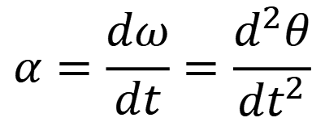
Angular velocity and angular acceleration
Angular acceleration $α$ (unit: $rad.s^{−2}$):
$$α=\frac{dω}{dt}=\frac{d^{2}θ}{dt^{2}}$$
p
Notes:
PARLER LENTEMENT. As acceleration and velocity are related together, there is an angular acceleration which describe the change rate of the angular velocity. So, it is the time derivative of the angular velocity and the twice time derivative of the angle theta.

Slide 41


Angular velocity and angular acceleration
Angular acceleration $α$ (unit: $rad.s^{−2}$):
$$α=\frac{dω}{dt}=\frac{d^{2}θ}{dt^{2}}$$
p
For a uniform circular motion:
$$\frac{dω}{dt}=0$$
$ω$ is constant:
Notes:
PARLER LENTEMENT. If the angular velocity is constant, then we have a uniform circular motion we have described previously.

Slide 42

Angular velocity and angular acceleration
Angular acceleration $α$ (unit: $rad.s^{−2}$):
$$α=\frac{dω}{dt}=\frac{d^{2}θ}{dt^{2}}$$
p
For a uniform circular motion:
$$\frac{dω}{dt}=0$$
$ω$ is constant:
$$α=0$$
Notes:
PARLER LENTEMENT. And in the case of the uniform circular motion, the angular acceleration is zero.

Slide 43
1.5. The motion is relative
Notes:
PARLER LENTEMENT. Lets to finish this first part of description of classical mechanics. Now, we will see how the motion if relative. Certainly it is something you have seen in Highschool.

Slide 44
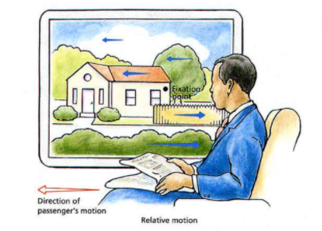
Introduction
To describe the motion of a particle, the reference system (i.e. the reference frame)can be chosen arbitrarily.
But the description of motion would be different in different reference frames.
http://www.rhsmpsychology.com/Handouts/monocular_cues_IV.htm
Notes:
PARLER LENTEMENT: To describe the motion of a particle, the reference system (i.e. the reference frame)can be chosen arbitrarily. But the description of motion would be different in different reference frames. You can see an example in the figure. For the man in the train, the house or a point of this house is moving toward the right. But for somebody in the house, the house is not moving but the train and its passenger are moving. You can see how it is important to choose a reference frame. Usually we choose a reference frame where the motion of a body is simple to describe.

Slide 45
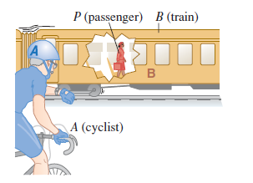
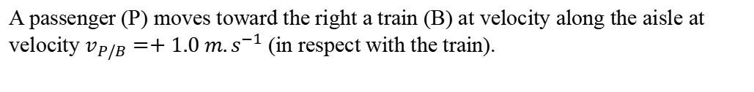
Introduction
A passenger (P) moves toward the right a train (B) at velocity along the aisle at velocity $v_{P/B}=+1.0 m.s^{−1}$ (in respect with the train).
Notes:
PARLER LENTEMENT: Here is another example. The train B moves toward the right. A passenger P moves toward the right at the velocity of 1 meter per second in respect to the train. You can see also a cyclist A at the ground.

Slide 46
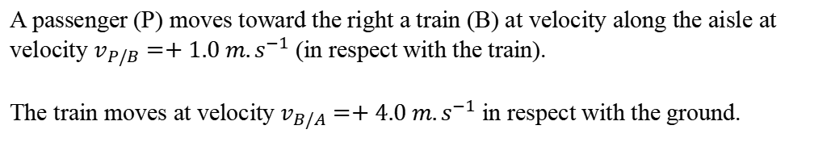
Introduction
A passenger (P) moves toward the right a train (B) at velocity along the aisle at velocity $v_{P/B}=+1.0 m.s^{−1}$ (in respect with the train).
The train moves at velocity$v_{B/A}=+4.0 m.s^{−1}$ in respect with the ground.
Notes:
PARLER LENTEMENT. And the train moves at the velocity of 4 meter per second.

Slide 47
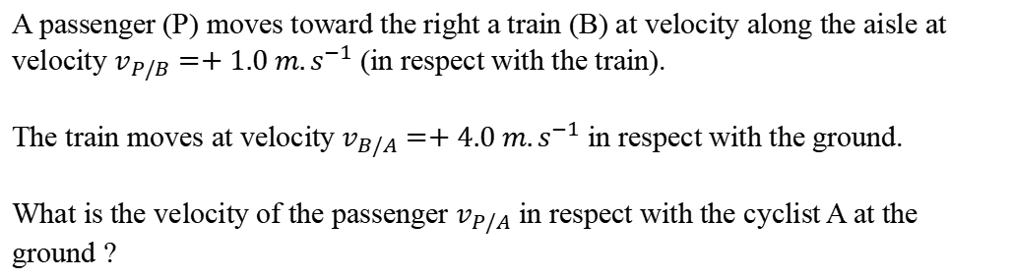
Introduction
A passenger (P) moves toward the right a train (B) at velocity along the aisle at velocity $v_{P/B}=+1.0 m.s^{−1}$ (in respect with the train).
The train moves at velocity$v_{B/A}=+4.0 m.s^{−1}$ in respect with the ground.
What is the velocity of the passenger $v_{P/A}$ in respect with the cyclist A at the ground ?
Notes:
PARLER LENTEMENT. So, what is the velocity of the passenger in respect with the cyclist A ?

Slide 48

Introduction
A passenger (P) moves toward the right a train (B) at velocity along the aisle at velocity $v_{P/B}=+1.0 m.s^{−1}$ (in respect with the train).
The train moves at velocity$v_{B/A}=+4.0 m.s^{−1}$ in respect with the ground.
What is the velocity of the passenger $v_{P/A}$ in respect with the cyclist A at the ground ?
$$v_{P/A}=v_{P/B}+v_{B/A}=5.0 m.s^{−1}$$
Notes:
PARLER LENTEMENT. It is simply 5 meters per second. We just have to add the velocity of the passenger in respect to the train and the velocity of the train in respect with the cyclist.

Slide 49
Introduction
A passenger (P) moves toward the right a train (B) at velocity along the aisle at velocity $v_{P/B}=+1.0 m.s^{−1}$ (in respect with the train).
The train moves at velocity$v_{B/A}=+4.0 m.s^{−1}$ in respect with the ground.
What is the velocity of the passenger $v_{P/A}$ in respect with the cyclist A at the ground ?
$$v_{P/A}=v_{P/B}+v_{B/A}=5.0 m.s^{−1}$$
But this situation is quite simple, in straight line, what about more complicated situations ?
Notes:
PARLER LENTEMENT. But this example is quite simple. What about more complicated situations. This is what we will describe after a rest time …

Slide 50
REST TIME

Slide 51










Two reference frames S and S’
$$y$$
Two reference frames S and S’:
$$y′$$
$$S=\left\{O,x,y,z,t\right\}$$
$$P$$
$$S′=\left\{O′,x′,y′,z′,t\right\}$$
$$+$$
$$\vec{r}$$
$$\vec{r}′$$
$$O′$$
$$x′$$
$$O$$
$$x$$
Point P describes the position of particle which can move with time in both reference frames.
Notes:
PARLER LENTEMENT. Here you can two reference frames S and S’. The position of the particle or point P is not described by the same position vector. In this example, the axis of both reference frames are parallel but it could be different. Their origin is not the same: O for the reference frame S, O prime for the reference frame S prime.

Slide 52
Two reference frames S and S’
$$y$$
Two reference frames S and S’:
$$y′$$
$$S=\left\{O,x,y,z,t\right\}$$
$$P$$
$$S′=\left\{O′,x′,y′,z′,t\right\}$$
$$+$$
$$\vec{r}$$
$$\vec{r}′$$
$$O′$$
$$x′$$
$$O$$
$$x$$
Point P describes the position of particle which can move with time in both reference frames.
The position vector of point P in reference frame S is: $\vec{r}=\vec{OP}$
Notes:
PARLER LENTEMENT: The position vector of point P in reference frame S is the vector between O and P.

Slide 53
Two reference frames S and S’
$$y$$
Two reference frames S and S’:
$$y′$$
$$S=\left\{O,x,y,z,t\right\}$$
$$P$$
$$S′=\left\{O′,x′,y′,z′,t\right\}$$
$$+$$
$$\vec{r}$$
$$\vec{r}′$$
$$O′$$
$$x′$$
$$O$$
$$x$$
Point P describes the position of particle which can move with time in both reference frames.
The position vector of point P in reference frame S is: $\vec{r}=\vec{OP}$
The position vector of point P in reference frame S’ is: $\vec{r}=\vec{O′P}$
Notes:
PARLER LENTEMENT: And the position vector of point P in reference frame S prime is the vector between O prime and P.

Slide 54
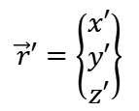
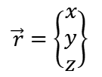
Two reference frames S and S’
$$y$$
Two reference frames S and S’:
$$y′$$
$$S=\left\{O,x,y,z,t\right\}$$
$$P$$
$$S′=\left\{O′,x′,y′,z′,t\right\}$$
$$+$$
$$\vec{r}$$
$$\vec{r}′$$
$$O′$$
$$x′$$
$$O$$
$$x$$
Coordinates of the position vectors in both reference frames:
$$\vec{r}′=\left\{\begin{matrix}x′ \\ y′ \\ z′\end{matrix}\right\}$$
$$\vec{r}=\left\{\begin{matrix}x \\ y \\ z\end{matrix}\right\}$$
Notes:
PARLER LENTEMENT:Here are the coordinates of the position vectors of P in both reference frames. As you can see, they don’t have the same coordinates.

Slide 55

Two reference frames S and S’
$$y$$
Two reference frames S and S’:
$$y′$$
$$S=\left\{O,x,y,z,t\right\}$$
$$P$$
$$S′=\left\{O′,x′,y′,z′,t\right\}$$
$$+$$
$$\vec{r}$$
$$\vec{r}′$$
$$O′$$
$$x′$$
$$\vec{R}$$
$$O$$
$$x$$
Relation between both positions vectors $\vec{r}$ and $\vec{r′}$
Notes:
PARLER LENTEMENT: Now, let’s see the relationship between these two position vectors. Lets describe the vector OO’ by the letter uppercase R.

Slide 56


Two reference frames S and S’
$$y$$
Two reference frames S and S’:
$$y′$$
$$S=\left\{O,x,y,z,t\right\}$$
$$P$$
$$S′=\left\{O′,x′,y′,z′,t\right\}$$
$$+$$
$$\vec{r}$$
$$\vec{r}′$$
$$O′$$
$$x′$$
$$\vec{R}$$
$$O$$
$$x$$
Relation between both positions vectors $\vec{r}$ and $\vec{r′}$
$$\vec{r}=\vec{r′}+\vec{R}$$
where $\vec{R}=\vec{OO′}$
Notes:
PARLER LENTEMENT: You can see that the position vector in reference frame S is simply the position vector in S’ + this vector between both origins O and O prime.

Slide 57
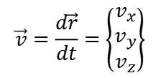
Two reference frames S and S’
$$y$$
Two reference frames S and S’:
$$y′$$
$$S=\left\{O,x,y,z,t\right\}$$
$$P$$
$$S′=\left\{O′,x′,y′,z′,t\right\}$$
$$+$$
$$\vec{r}$$
$$\vec{r}′$$
$$O′$$
$$x′$$
$$O$$
$$x$$
Velocity vectors of point P in both reference frames:
In S:
$$\vec{v}=\frac{d\vec{r}}{dt}=\left\{\begin{matrix}v_{x} \\ v_{y} \\ v_{z}\end{matrix}\right\}$$
Notes:
PARLER LENTEMENT: from the position vector we can describe the velocity. Here v is the velocity vector of P in the reference frame S.

Slide 58
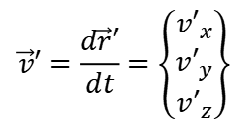
Two reference frames S and S’
$$y$$
Two reference frames S and S’:
$$y′$$
$$S=\left\{O,x,y,z,t\right\}$$
$$P$$
$$S′=\left\{O′,x′,y′,z′,t\right\}$$
$$+$$
$$\vec{r}$$
$$\vec{r}′$$
$$O′$$
$$x′$$
$$O$$
$$x$$
Velocity vectors of point P in both reference frames:
In S:
In S’:
$$\vec{v}′=\frac{d\vec{r}′}{dt}=\left\{\begin{matrix}{v′}_{x} \\ {v′}_{y} \\ {v′}_{z}\end{matrix}\right\}$$
$$\vec{v}=\frac{d\vec{r}}{dt}=\left\{\begin{matrix}v_{x} \\ v_{y} \\ v_{z}\end{matrix}\right\}$$
Notes:
PARLER LENTEMENT: And v prime is the velocity of P in the reference frame S’. We know the relationship between the position vector of P in both reference frame, so we know the relationship between its velocity vector in both reference frames.

Slide 59
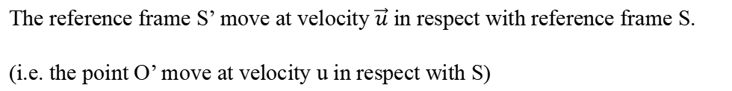
Two reference frames S and S’
$$y$$
$$\vec{u}$$
Two reference frames S and S’:
$$y′$$
$$S=\left\{O,x,y,z,t\right\}$$
$$P$$
$$S′=\left\{O′,x′,y′,z′,t\right\}$$
$$+$$
$$\vec{r}$$
$$\vec{r}′$$
$$O′$$
$$x′$$
$$\vec{R}$$
$$O$$
$$x$$
The reference frame S’ move at velocity $\vec{u}$ in respect with reference frame S.
(i.e. the point O’ move at velocity u in respect with S)
Notes:
PARLER LENTEMENT: To describe this relationship, We will consider that O prime moves at velocity u in respect to O, for instance in the direction shown on the figure. We can also say “The reference frame S prime move at velocity u in respect with reference frame S.

Slide 60

Two reference frames S and S’
$$y$$
$$\vec{u}$$
Two reference frames S and S’:
$$y′$$
$$S=\left\{O,x,y,z,t\right\}$$
$$P$$
$$S′=\left\{O′,x′,y′,z′,t\right\}$$
$$+$$
$$\vec{r}$$
$$\vec{r}′$$
$$O′$$
$$x′$$
$$\vec{R}$$
$$O$$
$$x$$
The reference frame S’ move at velocity $\vec{u}$ in respect with reference frame S.
(i.e. the point O’ move at velocity u in respect with S)
$$\vec{u}=\left\{\begin{matrix}u_{x} \\ u_{y} \\ u_{z}\end{matrix}\right\}$$
Notes:
PARLER LENTEMENT: This velocity vector has 3 coordinates in the reference frame S.

Slide 61
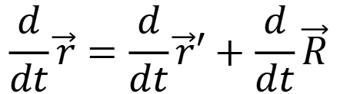

Relative motion
$$\vec{r}=\vec{r}′+\vec{R}$$
$$\frac{d}{dt}\vec{r}=\frac{d}{dt}\vec{r}′+\frac{d}{dt}\vec{R}$$
Notes:
PARLER LENTEMENT: From the relationship between the position vector in both reference frame, we obtain this equation by simply do the time iterative on each term of the equation.

Slide 62

Relative motion
$$\vec{r}=\vec{r}′+\vec{R}$$
$$\frac{d}{dt}\vec{r}=\frac{d}{dt}\vec{r}′+\frac{d}{dt}\vec{R}$$
$$\vec{v}=\vec{v}′+\vec{u}$$
where
$\vec{v}=d\vec{r}/dt$ is the velocity vector of P in reference frame S
$\vec{v′}=d\vec{r′}/dt$ is the velocity vector of P in reference frame S’
Notes:
PARLER LENTEMENT: And these terms are simply the velocity vector of P in reference frame S and S’ plus the velocity u .

Slide 63

Relative motion
$$\vec{r}=\vec{r}′+\vec{R}$$
$$\frac{d}{dt}\vec{r}=\frac{d}{dt}\vec{r}′+\frac{d}{dt}\vec{R}$$
$$\vec{v}=\vec{v}′+\vec{u}$$
where
$\vec{v}=d\vec{r}/dt$ is the velocity vector of P in reference frame S
$\vec{v′}=d\vec{r′}/dt$ is the velocity vector of P in reference frame S’
Relations between the coordinates of the velocity vectors:
$$v_{x}={v′}_{x}+u_{x}$$
Notes:
PARLER LENTEMENT: Often it is more easy to describe motion by using vectors in equations. But we can also use their coordinates. Here is the relationship between the x-coordinate of each of these vectors.

Slide 64


Relative motion
$$\vec{r}=\vec{r}′+\vec{R}$$
$$\frac{d}{dt}\vec{r}=\frac{d}{dt}\vec{r}′+\frac{d}{dt}\vec{R}$$
$$\vec{v}=\vec{v}′+\vec{u}$$
where
$\vec{v}=d\vec{r}/dt$ is the velocity vector of P in reference frame S
$\vec{v′}=d\vec{r′}/dt$ is the velocity vector of P in reference frame S’
Relations between the coordinates of the velocity vectors:
$$v_{x}={v′}_{x}+u_{x}$$
$$v_{y}={v′}_{y}+u_{y}$$
$$v_{z}={v′}_{z}+u_{z}$$
Notes:
PARLER LENTEMENT: In the same way we can describe the relationship between their y and z coordinates.

Slide 65


Exercise (5 minutes)
$$y$$
$$\vec{u}$$
Two reference frames S and S’:
$$y′$$
$$S=\left\{O,x,y,z,t\right\}$$
$$P$$
$$S′=\left\{O′,x′,y′,z′,t\right\}$$
$$+$$
$$\vec{r}$$
$$\vec{r′}$$
$$O′$$
$$x′$$
$$\vec{R}$$
$$O$$
$$x$$
We consider both reference frames coincide at the time $t=0$. The reference frame $S′$ moves at constant velocity $\vec{u}$ in respect with S:
$$\vec{R}=\vec{u}t$$
What is the relation between acceleration vector of P in both reference frames S and S’ ?
Notes:
PARLER LENTEMENT: So here is a little exercise. Please to try to do it in 5 minutes. We consider the following situation. At the time t=0, the origin of both reference frames coincides, so both reference frames coincide. After t equal zero, the reference frame S prime move at the velocity u, thus the vector between O and O’ depend on the time t as shown by this equation. Please to describe the relationship between the acceleration vector of P in both reference frames.

Slide 66

Solution
$$\vec{r}=\vec{r}′+\vec{R}$$
$$\vec{v}=\vec{v}′+\vec{u}$$
Acceleration vector of point P in reference frame S:
$$\vec{a}=\frac{d\vec{v}}{dt}$$
Notes:
PARLER LENTEMENT: Here is the solution for this first exercise. First, we describe the acceleration vector in the reference frame S. It is the time derivative of the velocity.

Slide 67

Solution
$$\vec{r}=\vec{r}′+\vec{R}$$
$$\vec{v}=\vec{v}′+\vec{u}$$
Acceleration vector of point P in reference frame S:
$$\vec{a}=\frac{d\vec{v}}{dt}$$
Acceleration vector of point P in reference frame S’:
$$\vec{a}′=\frac{d\vec{v}′}{dt}$$
Notes:
PARLER LENTEMENT: And we describe the acceleration of P in the reference frame S’.

Slide 68
Solution
$$\vec{r}=\vec{r}′+\vec{R}$$
$$\vec{v}=\vec{v}′+\vec{u}$$
Acceleration vector of point P in reference frame S:
$$\vec{a}=\frac{d\vec{v}}{dt}$$
Acceleration vector of point P in reference frame S’:
$$\vec{a}′=\frac{d\vec{v}′}{dt}$$
$$\vec{v}=\vec{v}′+\vec{u}$$
Notes:
PARLER LENTEMENT: We know the relationship between the velocities in both reference frames.

Slide 69
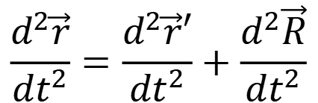
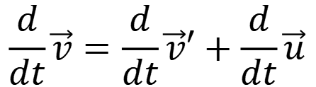
Solution
$$\vec{r}=\vec{r}′+\vec{R}$$
$$\vec{v}=\vec{v}′+\vec{u}$$
Acceleration vector of point P in reference frame S:
$$\vec{a}=\frac{d\vec{v}}{dt}$$
Acceleration vector of point P in reference frame S’:
$$\vec{a}′=\frac{d\vec{v}′}{dt}$$
$$\frac{d}{dt}\vec{v}=\frac{d}{dt}\vec{v}′+\frac{d}{dt}\vec{u}$$
$$\vec{v}=\vec{v}′+\vec{u}$$
$$\frac{d^{2}\vec{r}}{dt^{2}}=\frac{d^{2}\vec{r}′}{dt^{2}}+\frac{d^{2}\vec{R}}{dt^{2}}$$
Notes:
PARLER LENTEMENT: We have just to do the time derivative in each terms of the equation. Or we have just to do the twice time derivative of the equation involved with the positions vectors.

Slide 70
Solution
$$\frac{d}{dt}\vec{v}=\frac{d}{dt}\vec{v}′+\frac{d}{dt}\vec{u}$$
$$\frac{d^{2}\vec{r}}{dt^{2}}=\frac{d^{2}\vec{r}′}{dt^{2}}+\frac{d^{2}\vec{R}}{dt^{2}}$$
But here, the vector $\vec{u}$ is constant and $\vec{R}=\vec{u}t$.
Notes:
PARLER LENTEMENT: In this exercise, the velocity vector u is constant.

Slide 71
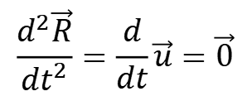
Solution
$$\frac{d}{dt}\vec{v}=\frac{d}{dt}\vec{v}′+\frac{d}{dt}\vec{u}$$
$$\frac{d^{2}\vec{r}}{dt^{2}}=\frac{d^{2}\vec{r}′}{dt^{2}}+\frac{d^{2}\vec{R}}{dt^{2}}$$
$$\frac{d^{2}\vec{R}}{dt^{2}}=\frac{d}{dt}\vec{u}=\vec{0}$$
But here, the vector $\vec{u}$ is constant and $\vec{R}=\vec{u}t$.
Notes:
PARLER LENTEMENT: So, its time derivative is zero.

Slide 72
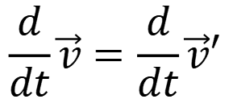
Solution
$$\frac{d}{dt}\vec{v}=\frac{d}{dt}\vec{v}′+\frac{d}{dt}\vec{u}$$
$$\frac{d^{2}\vec{r}}{dt^{2}}=\frac{d^{2}\vec{r}′}{dt^{2}}+\frac{d^{2}\vec{R}}{dt^{2}}$$
$$\frac{d^{2}\vec{R}}{dt^{2}}=\frac{d}{dt}\vec{u}=\vec{0}$$
But here, the vector $\vec{u}$ is constant and $\vec{R}=\vec{u}t$.
$$\frac{d}{dt}\vec{v}=\frac{d}{dt}\vec{v}′$$
We obtain:
Notes:
PARLER LENTEMENT: We obtain that the time derivative of the velocity vectors of P in both reference frame are equal.

Slide 73

Solution
$$\frac{d}{dt}\vec{v}=\frac{d}{dt}\vec{v}′+\frac{d}{dt}\vec{u}$$
$$\frac{d^{2}\vec{r}}{dt^{2}}=\frac{d^{2}\vec{r}′}{dt^{2}}+\frac{d^{2}\vec{R}}{dt^{2}}$$
$$\frac{d^{2}\vec{R}}{dt^{2}}=\frac{d}{dt}\vec{u}=\vec{0}$$
But here, the vector $\vec{u}$ is constant and $\vec{R}=\vec{u}t$.
$$\frac{d}{dt}\vec{v}=\frac{d}{dt}\vec{v}′$$
We obtain:
$$\vec{a}′=\vec{a}$$
The acceleration vector of P is the same in both reference frames.
Notes:
PARLER LENTEMENT: Thus, the acceleration vector of P is the same in both reference frames.

Slide 74
Solution
$$\frac{d}{dt}\vec{v}=\frac{d}{dt}\vec{v}′+\frac{d}{dt}\vec{u}$$
$$\frac{d^{2}\vec{r}}{dt^{2}}=\frac{d^{2}\vec{r}′}{dt^{2}}+\frac{d^{2}\vec{R}}{dt^{2}}$$
$$\frac{d^{2}\vec{R}}{dt^{2}}=\frac{d}{dt}\vec{u}=\vec{0}$$
But here, the vector $\vec{u}$ is constant and $\vec{R}=\vec{u}t$.
$$\frac{d}{dt}\vec{v}=\frac{d}{dt}\vec{v}′$$
We obtain:
$$\vec{a}′=\vec{a}$$
The acceleration vector of P is the same in both reference frames.
An inertial reference frame move at constant velocity in respect to another inertial reference frame.
Notes:
PARLER LENTEMENT: Maybe this remind you one characteristic of inertial reference frames. It is that An inertial reference frame move at constant velocity in respect to another inertial reference frame.

Slide 75
Solution
$$\frac{d}{dt}\vec{v}=\frac{d}{dt}\vec{v}′+\frac{d}{dt}\vec{u}$$
$$\frac{d^{2}\vec{r}}{dt^{2}}=\frac{d^{2}\vec{r}′}{dt^{2}}+\frac{d^{2}\vec{R}}{dt^{2}}$$
$$\frac{d^{2}\vec{R}}{dt^{2}}=\frac{d}{dt}\vec{u}=\vec{0}$$
But here, the vector $\vec{u}$ is constant and $\vec{R}=\vec{u}t$.
$$\frac{d}{dt}\vec{v}=\frac{d}{dt}\vec{v}′$$
We obtain:
$$\vec{a}′=\vec{a}$$
The acceleration vector of P is the same in both reference frames.
An inertial reference frame move at constant velocity in respect to another inertial reference frame.
In inertial reference frames (even if both reference frames don’t coincide at time $t=0$), the acceleration vector of a particle is the same.
Notes:
PARLER LENTEMENT: And a property of inertial reference frames is that the acceleration vector of the particle is the same in both inertial reference frames.

Slide 76
Inertial reference frames
An inertial reference frame is a reference frame which verify the Newton’s laws of motion (I reminds you them in details later).
Notes:
PARLER LENTEMENT: Now, I will describe you some details about inertial reference frames. First, An inertial reference frame is a reference frame which verify the Newton’s laws of motion. You should know the Newton’s laws of motion, I will remind you them later.

Slide 77
Inertial reference frames
An inertial reference frame is a reference frame which verify the Newton’s laws of motion (I reminds you them in details later).
An inertial reference frame move at constant velocity in respect with another inertial reference frame.
Notes:
PARLER LENTEMENT: As we have seen, an inertial reference frame move at constant velocity in respect with another inertial reference frame.

Slide 78
Inertial reference frames
An inertial reference frame is a reference frame which verify the Newton’s laws of motion (I reminds you them in details later).
An inertial reference frame move at constant velocity in respect with another inertial reference frame.
The acceleration vector of a particle is the same in two different inertial reference frames.
Notes:
PARLER LENTEMENT: And the acceleration vector of a particle is the same in two different inertial reference frames.

Slide 79
REST TIME (5 MINUTES)
ASK ME QUESTIONS ON THE WECHAT GROUP IF YOU HAVE :p

Slide 80
Summary
Relation between position vectors of point P in both reference frames
$$\vec{r}=\vec{r}′+\vec{R}$$
Relation between velocity vectors of point P in both reference frames
$$\vec{v}=\vec{v}′+\vec{u}$$
Notes:
PARLER LENTEMENT: In this slide, I just summary as equations the relationships between two reference frames, I means, between the position vector, the velocity vector and the acceleration vector in both reference frames. First, we have seen the relationship between the position vector of a particle in both reference frames and the relationship between the velocity vector of the particle in both reference frames.

Slide 81
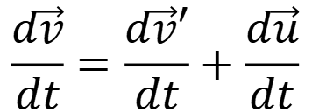
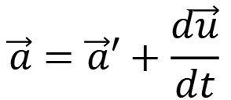
Summary
Relation between position vectors of point P in both reference frames
$$\vec{r}=\vec{r}′+\vec{R}$$
Relation between velocity vectors of point P in both reference frames
$$\vec{v}=\vec{v}′+\vec{u}$$
Relation between acceleration vectors of P in both reference frames
$$\frac{d\vec{v}}{dt}=\frac{d\vec{v}′}{dt}+\frac{d\vec{u}}{dt}$$
$$\vec{a}=\vec{a}′+\frac{d\vec{u}}{dt}$$
Notes:
PARLER LENTEMENT: Then we have seen the relationship between the acceleration vector of the particle in both reference frames.

Slide 82

Summary
Relation between position vectors of point P in both reference frames
$$\vec{r}=\vec{r}′+\vec{R}$$
Relation between velocity vectors of point P in both reference frames
$$\vec{v}=\vec{v}′+\vec{u}$$
Relation between acceleration vectors of P in both reference frames
$$\frac{d\vec{v}}{dt}=\frac{d\vec{v}′}{dt}+\frac{d\vec{u}}{dt}$$
$$\vec{a}=\vec{a}′+\frac{d\vec{u}}{dt}$$
If $\vec{u}$ is constant (as for two inertial reference frames, for instance), then
$$\vec{a}=\vec{a}′$$
Notes:
PARLER LENTEMENT: In the case of inertial reference frames, the acceleration vector is the same in both reference frames, because one reference frame moves at constant velocity in respect to the other reference frame.

Slide 83


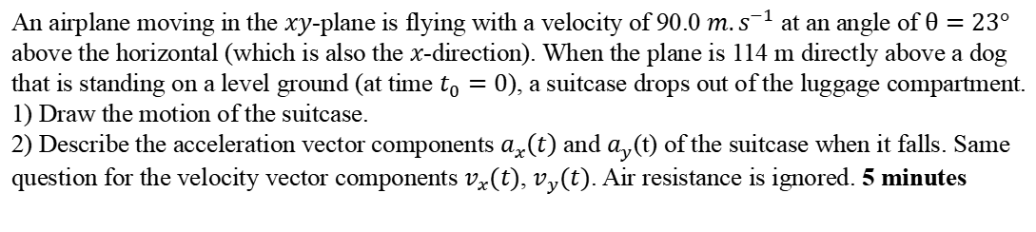

Ex. A parabolic motion
$$y$$
$$114 m$$
$$x$$
An airplane moving in the $xy$-plane is flying with a velocity of 90.0 $m.s^{−1}$ at an angle of $θ=23°$ above the horizontal (which is also the $x$-direction). When the plane is 114 m directly above a dog that is standing on a level ground (at time $t_{0}=0$), a suitcase drops out of the luggage compartment.
1) Draw the motion of the suitcase.
2) Describe the acceleration vector components $a_{x}\left(t\right)$ and $a_{y}$(t) of the suitcase when it falls. Same question for the velocity vector components $v_{x}(t)$, $v_{y}(t)$. Air resistance is ignored. 5 minutes
Notes:
PARLER LENTEMENT: To finish, here is a little exercise. On the figure you can see an airplane which is moving on the xy-plane at constant velocity at a certain angle above the x-axis. When the plane is at same x-coordinate than the dog, a suitcase drops out of the luggage compartiment. First please to describe by the acceleration vector of the suitcase when it falls. Then please to describe me the velocity vector of the suitcase when it falls.

Slide 84

Ex. A parabolic motion
$$y$$
$${\vec{v}}_{0}$$
$$θ$$
$$114 m$$
The suitcase has a parabolic motion we wish to describe
$$x$$
Notes:
PARLER LENTEMENT. So, first, let’s to describe the acceleration vector of the suitcase. The motion of it is a parabolic motion which is what we want to describe. When the plane is above the dog, the velocity vector of the suitcase is the velocity vector of the plane v0, we know its magnitude and we know the angle theta from what is described on the exercise.

Slide 85



Ex. A parabolic motion
Acceleration components
$$y$$
$${\vec{v}}_{0}$$
$$θ$$
$$a_{y}=−g$$
$$a_{x}=0$$
$$g=9.81 m.s^{−2}$$
$$114 m$$
$$x$$
Notes:
PARLER LENTEMENT. The suitcase is only submitted to the gravity. So, its acceleration is the gravitational acceleration. Then we know that the y-component of the acceleration is –g. Take care about the sign. This is because in this example, the y-axis is directed upward. But the gravitational acceleration is directed toward the ground, so downward. In this exercise, there is no acceleration of the suitcase toward the x-direction. So, the x-component of the acceleration is zero.

Slide 86



Ex. A parabolic motion
Acceleration components
$$y$$
$${\vec{v}}_{0}$$
$$θ$$
$$a_{y}=−g$$
$$a_{x}=0$$
$$g=9.81 m.s^{−2}$$
At time $t_{0}=0$, the suitcase drops out. Its velocity components are:
$$114 m$$
$$v_{0,x}=v_{0}\cos{θ}$$
$$v_{0,y}=v_{0}\sin{θ}$$
$$x$$
Notes:
PARLER LENTEMENT. Now, lets describe the velocity of the suitcase. But before, we have to describe its initial velocity when the suitcase drop. You can see that we can easily describe the x-component and the y-component of the initial velocity when the suitcase drops. v0, the magnitude of the initial velocity vector, and the angle theta are given in the exercise.

Slide 87

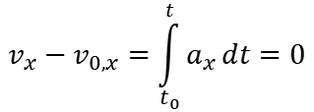
Ex. A parabolic motion
Acceleration components
$$y$$
$${\vec{v}}_{0}$$
$$θ$$
$$a_{y}=−g$$
$$a_{x}=0$$
$$g=9.81 m.s^{−2}$$
At time $t_{0}=0$, the suitcase drops out. Its velocity components are:
$$114 m$$
$$v_{0,x}=v_{0}\cos{θ}$$
$$v_{0,y}=v_{0}\sin{θ}$$
$$v_{x}−v_{0,x}=\int_{t_{0}}^{t}{a_{x}}dt=0$$
$$x$$
$$v_{x}(t)=v_{0,x}$$
Notes:
PARLER LENTEMENT. There is no acceleration in the x-direction, thus there is no change of velocity in the x-direction. The x-velocity of the suitcase is simply the x-component of the initial velocity,

Slide 88
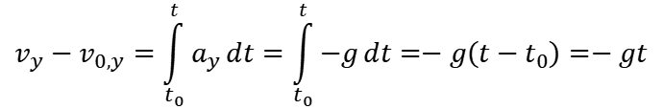
Ex. A parabolic motion
Acceleration components
$$y$$
$${\vec{v}}_{0}$$
$$θ$$
$$a_{y}=−g$$
$$a_{x}=0$$
$$g=9.81 m.s^{−2}$$
At time $t_{0}=0$, the suitcase drops out. Its velocity components are:
$$114 m$$
$$v_{0,x}=v_{0}\cos{θ}$$
$$v_{0,y}=v_{0}\sin{θ}$$
$$v_{x}−v_{0,x}=\int_{t_{0}}^{t}{a_{x}}dt=0$$
$$x$$
$$v_{x}(t)=v_{0,x}$$
$$v_{y}−v_{0,y}=\int_{t_{0}}^{t}{a_{y}}dt=\int_{t_{0}}^{t}{−g}dt=−g\left(t−t_{0}\right)=−gt$$
Notes:
PARLER LENTEMENT. For the y component of the velocity, we have to do an integral calculation as you can see with this equation.

Slide 89

Ex. A parabolic motion
Acceleration components
$$y$$
$${\vec{v}}_{0}$$
$$θ$$
$$a_{y}=−g$$
$$a_{x}=0$$
$$g=9.81 m.s^{−2}$$
At time $t_{0}=0$, the suitcase drops out. Its velocity components are:
$$114 m$$
$$v_{0,x}=v_{0}\cos{θ}$$
$$v_{0,y}=v_{0}\sin{θ}$$
$$v_{x}−v_{0,x}=\int_{t_{0}}^{t}{a_{x}}dt=0$$
$$x$$
$$v_{x}(t)=v_{0,x}$$
$$v_{y}−v_{0,y}=\int_{t_{0}}^{t}{a_{y}}dt=\int_{t_{0}}^{t}{−g}dt=−g\left(t−t_{0}\right)=−gt$$
$$v_{y}(t)=v_{0,y}−gt$$
Notes:
PARLER LENTEMENT: Finally, we obtain the expression of the y-component of the velocity. It is the y-component of initial velocity plus a term which depend to the time.

Slide 90

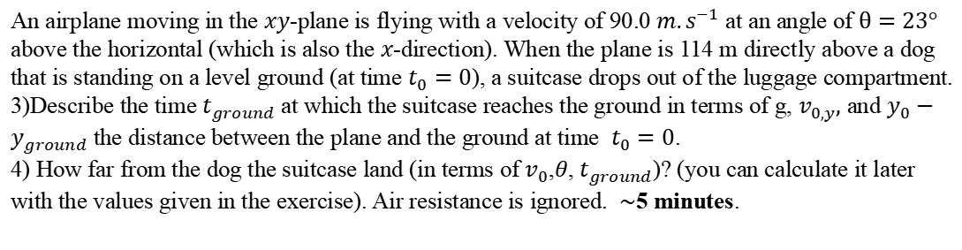
Ex. A parabolic motion
$$y$$
$$114 m$$
$$t_{ground }? x_{ground}?$$
$$x$$
An airplane moving in the $xy$-plane is flying with a velocity of 90.0 $m.s^{−1}$ at an angle of $θ=23°$ above the horizontal (which is also the $x$-direction). When the plane is 114 m directly above a dog that is standing on a level ground (at time $t_{0}=0$), a suitcase drops out of the luggage compartment.
3)Describe the time $t_{ground}$ at which the suitcase reaches the ground in terms of g, $v_{0,y},$ and $y_{0}−y_{ground}$ the distance between the plane and the ground at time $t_{0}=0$.
4) How far from the dog the suitcase land (in terms of $v_{0}$,$θ$, $t_{ground}$)? (you can calculate it later with the values given in the exercise). Air resistance is ignored. $\sim$5 minutes.
Notes:
PARLER LENTEMENT: Here is the next part of the exercise. Please to describe me first at which time the suitcase reaches the ground. Then Please to describe me at which distance from the dog it reaches the ground. I don’t ask here their values, but you can calculate them later. Please to do this in 5 minutes if you can.

Slide 91



Ex. A parabolic motion
$$y$$
$${\vec{v}}_{0}$$
$$v_{y}=v_{0,y}−gt$$
$$θ$$
We can describe the y-coordinate of the suitcase in respect to the time:
$$v_{y}=\frac{dy}{dt}$$
$$dy=v_{y}dt=\left(v_{0,y}−gt \right)dt$$
$$114 m$$
$$x$$
Notes:
PARLER LENTEMENT. Now, lets see if we can describe when and how far the suitcase reaches the ground. We can describe the y-coordinate of the suitcase by using integral calculation from the expression of the y-component of the velocity.

Slide 92


Ex. A parabolic motion
$$y$$
$${\vec{v}}_{0}$$
$$v_{y}=v_{0,y}−gt$$
$$θ$$
We can describe the y-coordinate of the suitcase in respect to the time:
$$v_{y}=\frac{dy}{dt}$$
$$dy=v_{y}dt=\left(v_{0,y}−gt \right)dt$$
$$114 m$$
$$y−y_{0}=v_{0,y}t−\frac{1}{2}gt^{2}$$
where $y_{0}$is the y-coordinate of the suitcase at time $t_{0}=0$.
$$x$$
Notes:
PARLER LENTEMENT. We obtain this expression which is characteristic of a parabolic motion y-0 is the coordinate of the suitcase at the time t0.

Slide 93


Ex. A parabolic motion
$$y$$
$${\vec{v}}_{0}$$
$$v_{y}=v_{0,y}−gt$$
$$θ$$
We can describe the y-coordinate of the suitcase in respect to the time:
$$v_{y}=\frac{dy}{dt}$$
$$dy=v_{y}dt=\left(v_{0,y}−gt \right)dt$$
$$114 m$$
$$y−y_{0}=v_{0,y}t−\frac{1}{2}gt^{2}$$
where $y_{0}$is the y-coordinate of the suite case at time $t_{0}=0$.
$$x$$
To find at which time the suitcase touch the ground:
$$−\frac{1}{2}gt^{2}+v_{0,y}t−\left(y_{ground}−y_{0}\right)=0$$
Notes:
PARLER LENTEMENT: So, we obtain a polynomial equation to solve. Certainly, you have seen before this kind of equation. You can see that by solving this equation. We obtain at which time the suitcase reaches the ground.

Slide 94


Ex. A parabolic motion
$$y$$
$${\vec{v}}_{0}$$
$$v_{y}=v_{0,y}−gt$$
$$θ$$
We can describe the y-coordinate of the suitcase in respect to the time:
$$v_{y}=\frac{dy}{dt}$$
$$dy=v_{y}dt=\left(v_{0,y}−gt \right)dt$$
$$114 m$$
$$y−y_{0}=v_{0,y}t−\frac{1}{2}gt^{2}$$
where $y_{0}$is the y-coordinate of the suite case at time $t_{0}=0$.
$$x$$
To find at which time the suitcase touch the ground:
$$−\frac{1}{2}gt^{2}+v_{0,y}t−\left(y_{ground}−y_{0}\right)=0$$
$$−\frac{1}{2}gt^{2}+v_{0,y}t+\left(y_{0}−y_{ground}\right)=0$$
where $y_{0}−y_{ground}=114 m$
Notes:
PARLER LENTEMENT: Here is the same equation in a more simplified from. You can see that to solve we must to know the distance between the plane and the dog at initial time. This is one hundred fourteen meters, which is shown on the figure.

Slide 95

Ex. A parabolic motion
$$y$$
$${\vec{v}}_{0}$$
$$−\frac{1}{2}gt^{2}+v_{0,y}t+\left(y_{0}−y_{ground}\right)=0$$
$$θ$$
Equation of the form (2nd degree polynomial equation):
Solutions:
$$at^{2}+bt+c=0$$
$$114 m$$
$$x$$
Notes:
PARLER LENTEMENT: So, let’s solve the polynomial equation. Here is an example of equation of second degree. The values coefficients a, b, and c are described from the information given by the exercise.

Slide 96



Ex. A parabolic motion
$$y$$
$${\vec{v}}_{0}$$
$$−\frac{1}{2}gt^{2}+v_{0,y}t+\left(y_{0}−y_{ground}\right)=0$$
$$θ$$
Equation of the form (2nd degree polynomial equation):
Solutions:
$$at^{2}+bt+c=0$$
$$t_{1}=\frac{−b−\sqrt{∆}}{2a}$$
$$t_{2}=\frac{−b+\sqrt{∆}}{2a}$$
where $∆=b^{2}−4ac$
$$114 m$$
$$x$$
Notes:
PARLER LENTEMENT: This equation permit to find two possibles solutions, I name here t1 and t2. Delta is the determinant of the equation.

Slide 97



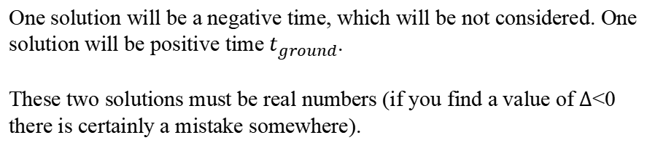
Ex. A parabolic motion
$$y$$
$${\vec{v}}_{0}$$
$$−\frac{1}{2}gt^{2}+v_{0,y}t+\left(y_{0}−y_{ground}\right)=0$$
$$θ$$
Equation of the form (2nd degree polynomial equation):
Solutions:
$$at^{2}+bt+c=0$$
$$t_{1}=\frac{−b−\sqrt{∆}}{2a}$$
$$t_{2}=\frac{−b+\sqrt{∆}}{2a}$$
where $∆=b^{2}−4ac$
$$114 m$$
One solution will be a negative time, which will be not considered. One solution will be positive time $t_{ground}$.
These two solutions must be real numbers (if you find a value of $∆$<0 there is certainly a mistake somewhere).
$$x$$
where
$$a=−\frac{1}{2}g$$
$$c=y_{0}−y_{ground}$$
$$b=v_{0,y}$$
Notes:
PARLER LENTEMENT: There are two solutions but only one of them correspond to the time at which the suitcase reach the ground. It is the positive solution. Take care that the both solution should be real numbers here or there is certainly a mistake somewhere. This question is not finished because we have to describe this time when the suitcase reaches the ground by the parameters of the exercise, not by the coefficients a,b, c which just help to solve this equation.

Slide 98
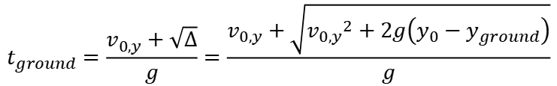
Ex. A parabolic motion
$$y$$
$${\vec{v}}_{0}$$
$$−\frac{1}{2}gt^{2}+v_{0,y}t+\left(y_{0}−y_{ground}\right)=0$$
$$θ$$
Equation of the form (2nd degree polynomial equation):
Solutions:
$$at^{2}+bt+c=0$$
$$t_{1}=\frac{−b−\sqrt{∆}}{2a}$$
$$t_{2}=\frac{−b+\sqrt{∆}}{2a}$$
where $∆=b^{2}−4ac$
$$114 m$$
One solution will be a negative time, which will be not considered. One solution will be positive time $t_{ground}$.
These two solutions must be real numbers (if you find a value of $∆$<0 there is certainly a mistake somewhere).
$$x$$
where
$$a=−\frac{1}{2}g$$
$$c=y_{0}−y_{ground}$$
$$b=v_{0,y}$$
$$t_{ground}=\frac{v_{0,y}+\sqrt{∆}}{g}=\frac{v_{0,y}+\sqrt{{v_{0,y}}^{2}+2g\left(y_{0}−y_{ground}\right)}}{g}$$
The second solution is negative.
Notes:
PARLER LENTEMENT: So, the positive solution of the polynomial equation is as follows. You can check the units to verify if you can see mistakes (it is the good exercise, even without values given here).

Slide 99







Ex. A parabolic motion
$${v_{0,y}}^{2}+2g\left(y_{0}−y_{ground}\right)$$
$$m^{2}.s^{−2}$$
$$m$$
$$m.s^{−1}$$
$$m.s^{−2}$$
$$\sqrt{{v_{0,y}}^{2}+2g\left(y_{0}−y_{ground}\right)}$$
$${m.s}^{−1}$$
Notes:
PARLER LENTEMENT: So, lets check the units. First, let’s begin to what is inside the square root. The velocity unit is the meter per second. The gravitational acceleration unit is the meter per square second. And the y-coordinate unit is the meter. We obtain that what is inside the square root as the unit square meter per square second. This means that if we do the square root of this unit, we obtain the unit of the velocity, the meter per second. Which is not a big surprise.

Slide 100
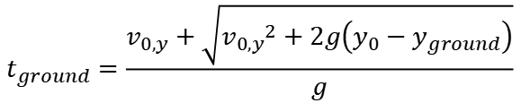
Ex. A parabolic motion
$$\sqrt{{v_{0,y}}^{2}+2g\left(y_{0}−y_{ground}\right)}$$
$${m.s}^{−1}$$
$$m.s^{−1}$$
$$t_{ground}=\frac{v_{0,y}+\sqrt{{v_{0,y}}^{2}+2g\left(y_{0}−y_{ground}\right)}}{g}$$
$$m.s^{−2}$$
The time unit should be the second. Everything seems ok !
Notes:
PARLER LENTEMENT: So, lets check the unit of the result. At the top of the equation which describe the time t ground, the units are meter per second. At the bottom, the unit is meter per square second. So the time described should have the second as unit. It seems there was no mistake here. Of course, even with that checking we could do mistakes, but at least we know there is no issue involved with the units,

Slide 101


Ex. A parabolic motion
$$y$$
$${\vec{v}}_{0}$$
$$−\frac{1}{2}gt^{2}+v_{0,y}t+\left(y_{0}−y_{ground}\right)=0$$
$$θ$$
Equation of the form (2nd degree polynomial equation):
Solutions:
$$at^{2}+bt+c=0$$
$$t_{1}=\frac{−b−\sqrt{∆}}{2a}$$
$$t_{2}=\frac{−b+\sqrt{∆}}{2a}$$
where $∆=b^{2}−4ac$
$$114 m$$
One solution will be a negative time, which will be not considered. One solution will be positive time $t_{ground}$.
These two solutions must be real numbers (if you find a value of $∆$<0 there is certainly a mistake somewhere).
$$x$$
$$v_{x}=\frac{dx}{dt}$$
$$dx=v_{x}dt$$
Notes:
PARLER LENTEMENT. Now, let’s describe how we can know how far the suitcase reach the ground. We can describe the x-coordinate of the suitcase from the x-component of its velocity.

Slide 102
Ex. A parabolic motion
$$y$$
$${\vec{v}}_{0}$$
$$−\frac{1}{2}gt^{2}+v_{0,y}t+\left(y_{0}−y_{ground}\right)=0$$
$$θ$$
Equation of the form (2nd degree polynomial equation):
Solutions:
$$at^{2}+bt+c=0$$
$$t_{1}=\frac{−b−\sqrt{∆}}{2a}$$
$$t_{2}=\frac{−b+\sqrt{∆}}{2a}$$
where $∆=b^{2}−4ac$
$$114 m$$
One solution will be a negative time, which will be not considered. One solution will be positive time $t_{ground}$.
These two solutions must be real numbers (if you find a value of $∆$<0 there is certainly a mistake somewhere).
$$x$$
$$v_{x}=\frac{dx}{dt}$$
$$dx=v_{x}dt$$
$$x−x_{0}=v_{0,x}\left(t−t_{0}\right)=v_{0,x}t=(v_{0}\cos{θ})t$$
Notes:
PARLER LENTEMENT. After a small integral calculation, we obtain this equation.

Slide 103
Ex. A parabolic motion
$$y$$
$${\vec{v}}_{0}$$
$$−\frac{1}{2}gt^{2}+v_{0,y}t+\left(y_{0}−y_{ground}\right)=0$$
$$θ$$
Equation of the form (2nd degree polynomial equation):
Solutions:
$$at^{2}+bt+c=0$$
$$t_{1}=\frac{−b−\sqrt{∆}}{2a}$$
$$t_{2}=\frac{−b+\sqrt{∆}}{2a}$$
where $∆=b^{2}−4ac$
$$114 m$$
One solution will be a negative time, which will be not considered. One solution will be positive time $t_{ground}$.
These two solutions must be real numbers (if you find a value of $∆$<0 there is certainly a mistake somewhere).
$$x$$
$$v_{x}=\frac{dx}{dt}$$
$$dx=v_{x}dt$$
$$x−x_{0}=v_{0,x}\left(t−t_{0}\right)=v_{0,x}t=(v_{0}\cos{θ})t$$
The suitcase touch the ground at time $t_{ground}$ at x-coordinate $x_{ground}$:
$$x_{ground}−x_{0}=v_{0,x}\left(t_{ground}−t_{0}\right)=v_{0,x}t_{ground}=(v_{0}\cos{θ})t_{ground}$$
Notes:
PARLER LENTEMENT. Thus, we can describe what is the x-coordinate of the suitcase when it reaches the ground. And if you use the values given by the exercise, you will find when and how far the suitcase reaches the ground. That’s all for this exercise.

Slide 104

About SI units:
SI unit of time is the second ($s$)
SI unit of $x,y,z,$ $r$,$s$ and corresponding displacements is the meter ($m$)
Notes:
PARLER LENTEMENT: Before to finish, I just want to summary what we have seen about units, because units are very important in physics. We have used the unit of the time, the SI unit is the second. The SI unit of the length is the meter.

Slide 105

About SI units:
SI unit of time is the second ($s$)
SI unit of $x,y,z,$ $r$,$s$ and corresponding displacements is the meter ($m$)
SI unit of velocity and its components ($v_{x},v_{y},v_{z},$and $v$) is $m.s^{−1}$
SI unit of acceleration and its components ($a_{x},a_{y},a_{z},a_{n},a_{t}$and $a$) is $m.s^{−2}$
Notes:
PARLER LENTEMENT: The SI unit of the velocity is meter per second. The SI unit of the acceleration is meter per square-second.

Slide 106

About SI units:
SI unit of time is the second ($s$)
SI unit of $x,y,z,$ $r$,$s$ and corresponding displacements is the meter ($m$)
SI unit of velocity and its components ($v_{x},v_{y},v_{z},$and $v$) is $m.s^{−1}$
SI unit of acceleration and its components ($a_{x},a_{y},a_{z},a_{n},a_{t}$and $a$) is $m.s^{−2}$
SI unit of the angular velocity $ω$: $rad.s^{−1}$
Notes:
PARLER LENTEMENT: The SI units of the angular velocity is the radians per seconds.

Slide 107

About SI units:
SI unit of time is the second ($s$)
SI unit of $x,y,z,$ $r$,$s$ and corresponding displacements is the meter ($m$)
SI unit of velocity and its components ($v_{x},v_{y},v_{z},$and $v$) is $m.s^{−1}$
SI unit of acceleration and its components ($a_{x},a_{y},a_{z},a_{n},a_{t}$and $a$) is $m.s^{−2}$
SI unit of the angular velocity $ω$: $rad.s^{−1}$
SI unit of the angular acceleration: $rad.s^{−2}$
Notes:
PARLER LENTEMENT. The SI unit of the angular acceleration is radians per square second. It could seems a lot but later we will see many other kinds of unit, so please to remember them well.

Slide 108
End of the lesson 3
Notes:
PARLER LENTEMENT: That’s all for today. See you next time !

